Slide 1
Introduction to Bioinformatics
Lecture 1

Slide 2
Bioinformatics
Welcome to the Introduction of bioinformatics class
Lecturer: A. Prof. Hilal Tayara
hilaltayara@jbnu.ac.kr
Office: Global Frontier College, 333
Monday
14:00-16:00
Wednesday
14:00-15:00
All materials are uploaded to https://ieilms.jbnu.ac.kr/

Slide 3
Contents
Genomic Analysis
Modeling Biological Function
Proteomics
Regulatory Networks
Computational Genetics

Slide 4
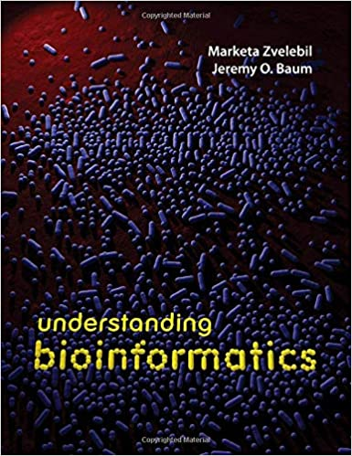
Books
Understanding Bioinformatics
Jeremy O. Baum and Marketa J. Zvelebil
Basic Probability and Statistics
Python

Slide 5
Grading
Midterm 25%
Final 35%
Assignments 30%
Attendance 10%

Slide 6
Bioinformatics
Bioinformatics is an interdisciplinary field that develops methods and software tools for understanding biological data, in particular when the data sets are large and complex.
As an interdisciplinary field of science, bioinformatics combines biology, computer science, information engineering, mathematics and statistics to analyze and interpret the biological data.
Bioinformatics has been used for in silico analyses of biological queries using mathematical and statistical techniques.

Slide 7
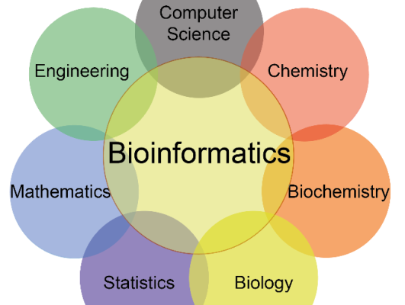
Bioinformatics

Slide 8
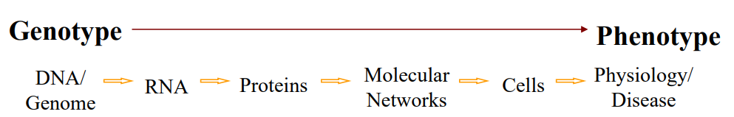
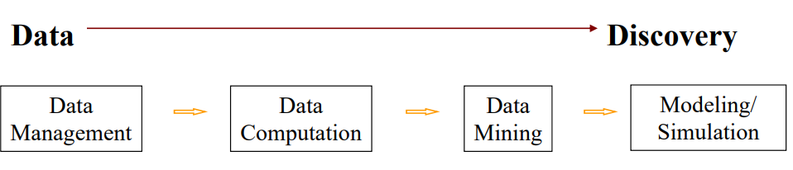
Bioinformatics
Bio + Informatics
Biology:
Informatics:

Slide 9
History of Bioinformatics
~ - 1970s
Sequence Databases, Similarity Matrices, and Molecular Evolution
How to study the similarity between two proteins?
How to score the similarity and detect homology?
First protein sequence databases / protein family classification
PAM matrices for protein sequence comparisons (still used!) [Margaret Dayhoff]
molecular sequences are helpful for studying organismal evolution [Carl Woese, Russ Doolittle]
Molecular classification of life
Molecular clocks
Use of ribosomal RNA to infer phylogeny
Discovery of third 'domain' of life - Archaea

Slide 10
History of Bioinformatics
The 1980s: Sequence Alignment/Search:
Which specific residues/positions in a pair of proteins are homologous?
Smith-Waterman alignment algorithm
What RNA secondary structure has minimum folding free energy?
Nussinov algorithm
Zuker algorithm
How to rapidly and reliably find homologs to a query sequence in a sequence database?
FastA and BLAST algorithms and associated statistics

Slide 11
History of Bioinformatics
The ‘90s: HMMs, Ab Initio Protein Structure Prediction, Genomics, Comparative Genomics
How to identify domains in a protein?
How to identify genes in a genome?
Hidden Markov Models as a framework for such problems How to study gene expression globally
How to study gene expression globally, infer gene function from expression?
Microarrays and clustering How to predict protein function by comparing genomes?
gene fusions, phylogenetic profiling, etc.
How to predict protein structure directly from primary sequence?
Rosetta algorithm
Alphafold2

Slide 12
History of Bioinformatics
The 2000s:
The human genome is sequenced, assembled, annotated
Biological Experiments Become High-Throughput, Computational Biology Becomes more Biological:
Massively parallel data collection - transcriptomics, proteomics, interactomics, metagenomics
Using sequence and array data to address fundamental questions about transcription, splicing, microRNAs, translation, epigenetics, protein structure/function, development, evolution, disease, etc.
Integrated computational/experimental approaches
Rise of bioimage informatics

Slide 13
History of Bioinformatics
The 2000s:
Systems Biology Models of gene and protein networks in development, disease, etc.
Synthetic Biology & Biological Engineering: Design of regulatory networks using biological components

Slide 14
History of Bioinformatics
Late 2000s / present:
Next-gen sequencing finds applications across biology
Genome sequencing
Transcriptome sequencing
Protein-DNA interactions (ChIP-seq)
Protein-RNA interactions (CLIP-seq)
Translatome, Methylome, Open chromatome
Deep learning

Slide 15
Motivating Questions
What instructions are encoded in our (and other) genomes?
How are chromosomes organized?
What genes are present?
What regulatory circuitry is encoded?
Can the transcriptome be predicted from the genome?
Can the proteome be predicted from the transcriptome?
Can protein function be predicted from sequence?
Can evolutionary history be reconstructed from sequence?

Slide 16

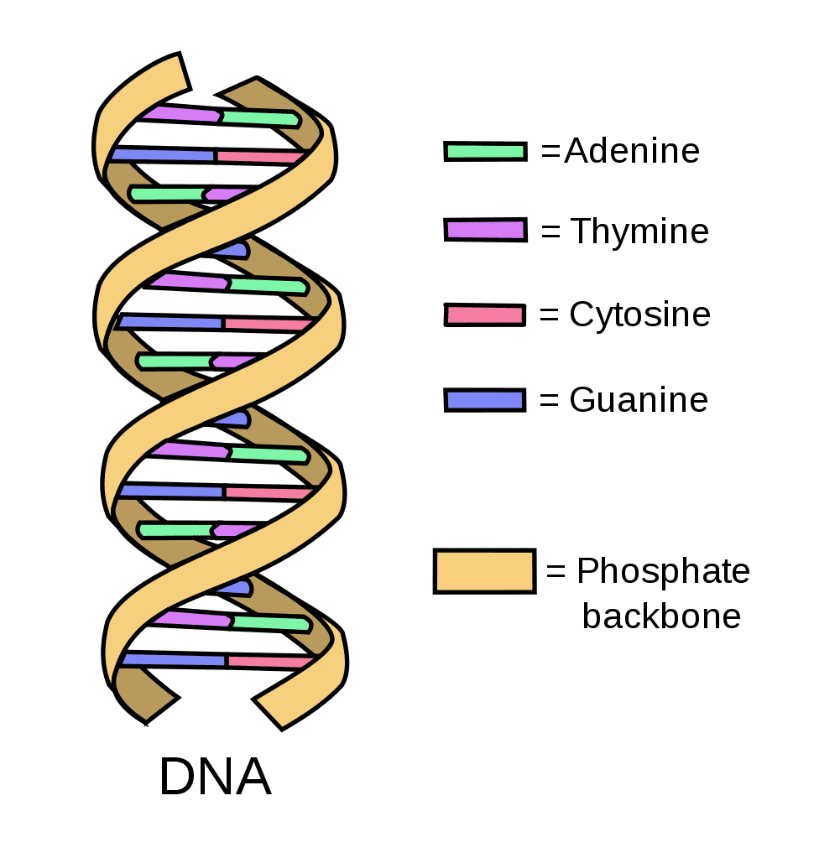
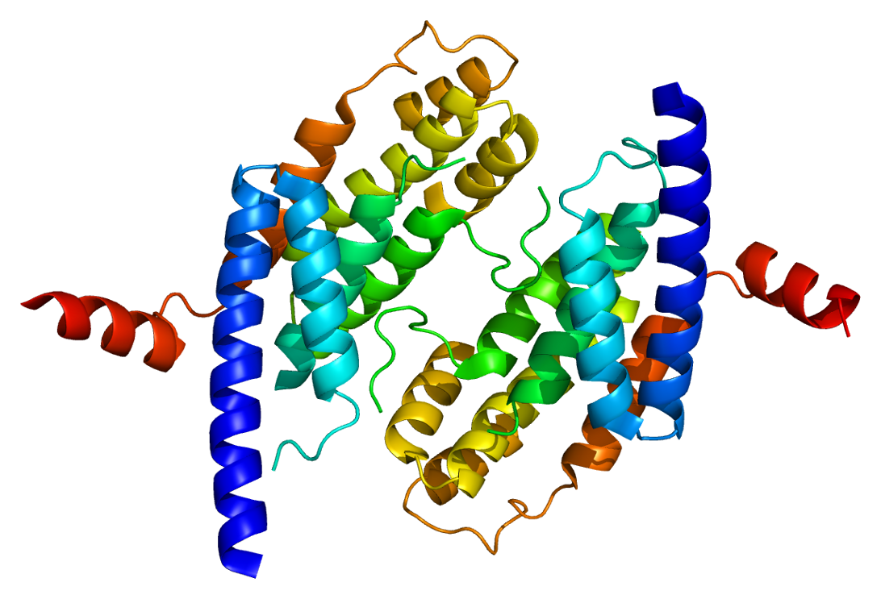
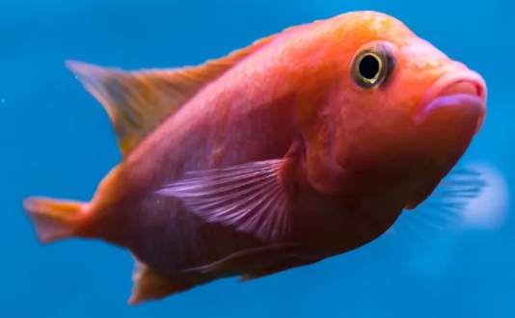
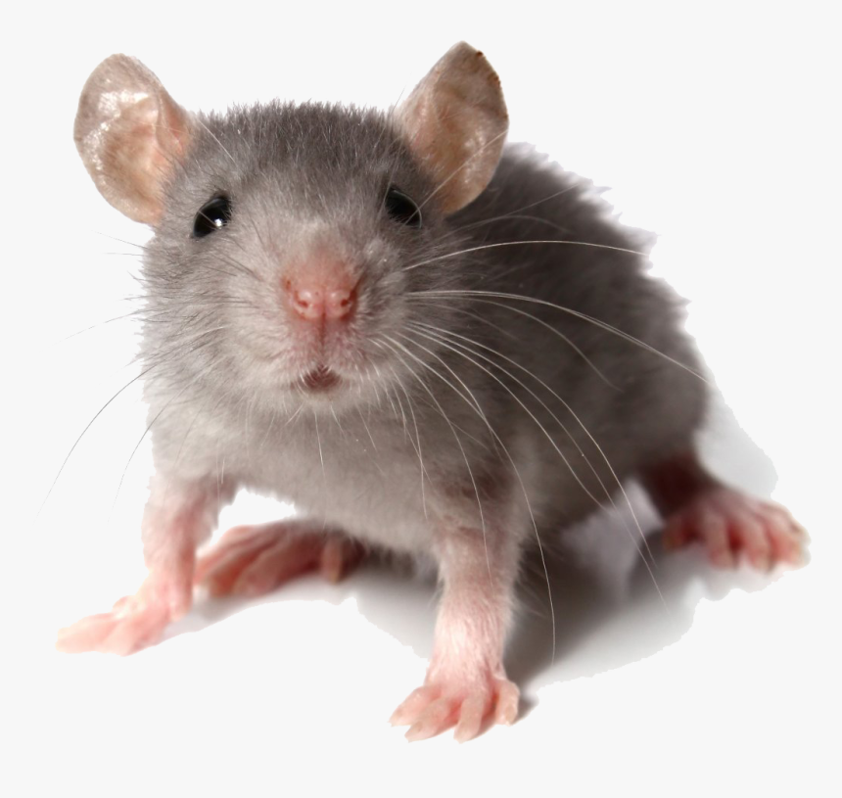
Scales of life
Protein

Slide 17
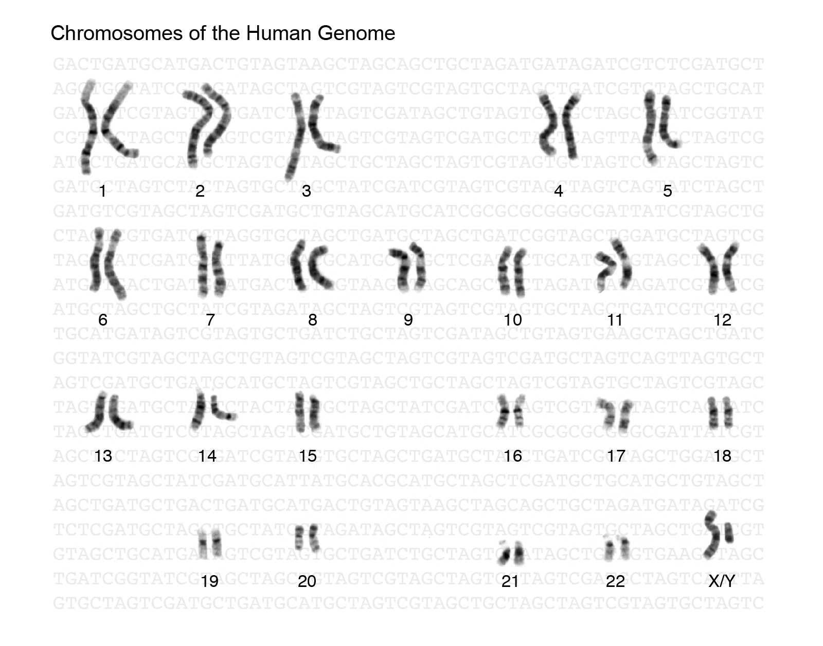
Genome
Credit: https://www.genome.gov/genetics-glossary/Genome

Slide 18
Molecular Biology Information - DNA
atggcaattaaaattggtatcaatggttttggtcgtatcggccgtatcgtattccgtgca
gcacaacaccgtgatgacattgaagttgtaggtattaacgacttaatcgacgttgaatac
atggcttatatgttgaaatatgattcaactcacggtcgtttcgacggcactgttgaagtg
aaagatggtaacttagtggttaatggtaaaactatccgtgtaactgcagaacgtgatcca
gcaaacttaaactggggtgcaatcggtgttgatatcgctgttgaagcgactggtttattc
ttaactgatgaaactgctcgtaaacatatcactgcaggcgcaaaaaaagttgtattaact
ggcccatctaaagatgcaacccctatgttcgttcgtggtgtaaacttcaacgcatacgca
ggtcaagatatcgtttctaacgcatcttgtacaacaaactgtttagctcctttagcacgt
gttgttcatgaaactttcggtatcaaagatggtttaatgaccactgttcacgcaacgact
gcaactcaaaaaactgtggatggtccatcagctaaagactggcgcggcggccgcggtgca
tcacaaaacatcattccatcttcaacaggtgcagcgaaagcagtaggtaaagtattacct
gcattaaacggtaaattaactggtatggctttccgtgttccaacgccaaacgtatctgtt
gttgatttaacagttaatcttgaaaaaccagcttcttatgatgcaatcaaacaagcaatc
aaagatgcagcggaaggtaaaacgttcaatggcgaattaaaaggcgtattaggttacact
gaagatgctgttgtttctactgacttcaacggttgtgctttaacttctgtatttgatgca
gacgctggtatcgcattaactgattctttcgttaaattggtatc . . .
. . . caaaaatagggttaatatgaatctcgatctccattttgttcatcgtattcaa
caacaagccaaaactcgtacaaatatgaccgcacttcgctataaagaacacggcttgtgg
cgagatatctcttggaaaaactttcaagagcaactcaatcaactttctcgagcattgctt
gctcacaatattgacgtacaagataaaatcgccatttttgcccataatatggaacgttgg
gttgttcatgaaactttcggtatcaaagatggtttaatgaccactgttcacgcaacgact
acaatcgttgacattgcgaccttacaaattcgagcaatcacagtgcctatttacgcaacc
aatacagcccagcaagcagaatttatcctaaatcacgccgatgtaaaaattctcttcgtc
ggcgatcaagagcaatacgatcaaacattggaaattgctcatcattgtccaaaattacaa
aaaattgtagcaatgaaatccaccattcaattacaacaagatcctctttcttgcacttgg
Raw DNA Sequence
Coding or Not?
Parse into genes?
4 bases: AGCT
~1 Kb in a gene, ~2 Mb in genome
~3 Gb Human

Slide 19
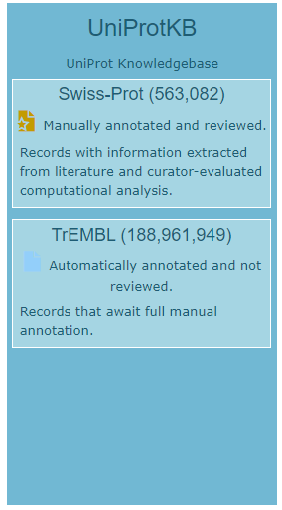
Molecular Biology Information: Protein Sequence
20 letter alphabet
ACDEFGHIKLMNPQRSTVWY but not BJOUXZ
Strings of ~300 aa in an average protein (in bacteria), ~200 aa in a domain
Millions of known protein sequences
d1dhfa_ LNCIVAVSQNMGIGKNGDLPWPPLRNEFRYFQRMTTTSSVEGKQ-NLVIMGKKTWFSI
d8dfr__ LNSIVAVCQNMGIGKDGNLPWPPLRNEYKYFQRMTSTSHVEGKQ-NAVIMGKKTWFSI
d4dfra_ ISLIAALAVDRVIGMENAMPWN-LPADLAWFKRNTL--------NKPVIMGRHTWESI
d3dfr__ TAFLWAQDRDGLIGKDGHLPWH-LPDDLHYFRAQTV--------GKIMVVGRRTYESF
d1dhfa_ LNCIVAVSQNMGIGKNGDLPWPPLRNEFRYFQRMTTTSSVEGKQ-NLVIMGKKTWFSI
d8dfr__ LNSIVAVCQNMGIGKDGNLPWPPLRNEYKYFQRMTSTSHVEGKQ-NAVIMGKKTWFSI
d4dfra_ ISLIAALAVDRVIGMENAMPW-NLPADLAWFKRNTLD--------KPVIMGRHTWESI
d3dfr__ TAFLWAQDRNGLIGKDGHLPW-HLPDDLHYFRAQTVG--------KIMVVGRRTYESF
https://www.uniprot.org/

Slide 20
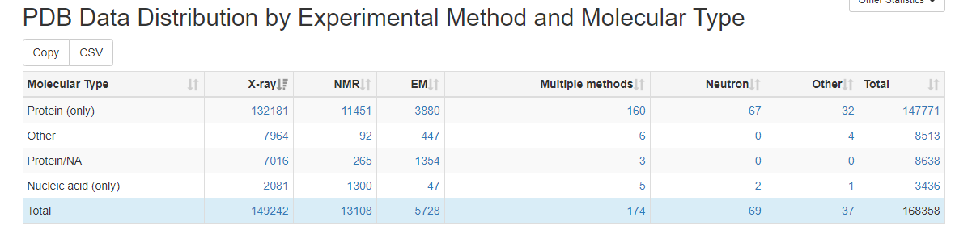
https://www.rcsb.org/stats/summary
https://www.uniprot.org/

Slide 21
Genes and Proteins
One gene encodes one* protein.
Like a program, it starts with start codon (e.g. ATG), then each three code one amino acid. Then a stop codon (e.g. TGA) signifies end of the gene.
Sometimes, in the middle of a (eukaryotic) gene, there are introns that are spliced out (as junk) during transcription. Coding parts are called exons. This is the task of gene finding.

Slide 22
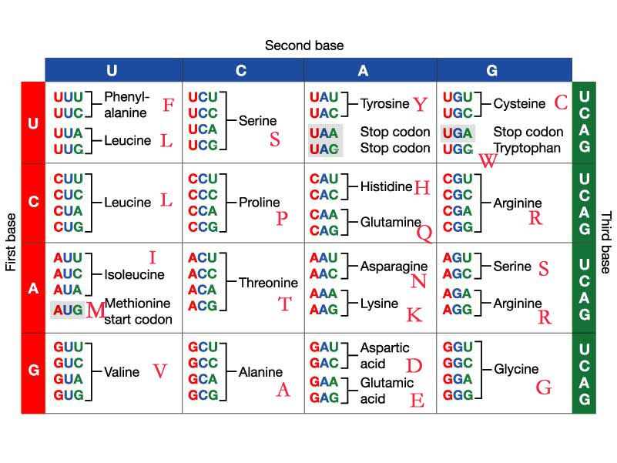
Amino Acid Coding Table

Slide 23
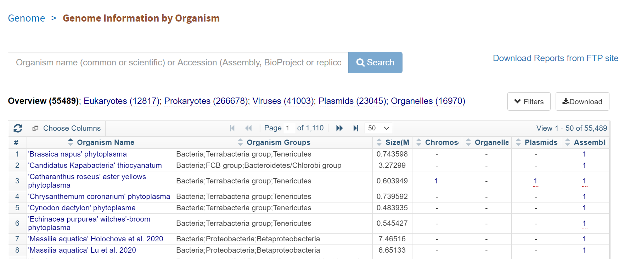
https://www.ncbi.nlm.nih.gov/genome/browse/#!/overview/

Slide 24
Where to get data?
GenBank
http://www.ncbi.nlm.nih.gov/genbank/
The Cancer Genome Atlas
http://cancergenome.nih.gov/
Protein Databases
UniPort, IntAct and others at EBI: http://www.ebi.ac.uk/services/proteins
PDB: http://www.rcsb.org/
UCSC Genome Browser:
http://genome.ucsc.edu/
And many others

Slide 25
GGCAGATTCCCCCTAGACCCGCCCGCACCATGGTCAGGCATGCCCCTCCTCATCGCTGGGCACAGCCCAGAGGGT ATAAACAGTGCTGGAGGCTGGCGGGGCAGGCCAGCTGAGTCCTGAGCAGCAGCCCAGCGCAGCCACCGAGACACC ATGAGAGCCCTCACACTCCTCGCCCTATTGGCCCTGGCCGCACTTTGCATCGCTGGCCAGGCAGGTGAGTGCCCC CACCTCCCCTCAGGCCGCATTGCAGTGGGGGCTGAGAGGAGGAAGCACCATGGCCCACCTCTTCTCACCCCTTTG GCTGGCAGTCCCTTTGCAGTCTAACCACCTTGTTGCAGGCTCAATCCATTTGCCCCAGCTCTGCCCTTGCAGAGG GAGAGGAGGGAAGAGCAAGCTGCCCGAGACGCAGGGGAAGGAGGATGAGGGCCCTGGGGATGAGCTGGGGTGAAC CAGGCTCCCTTTCCTTTGCAGGTGCGAAGCCCAGCGGTGCAGAGTCCAGCAAAGGTGCAGGTATGAGGATGGACC TGATGGGTTCCTGGACCCTCCCCTCTCACCCTGGTCCCTCAGTCTCATTCCCCCACTCCTGCCACCTCCTGTCTG GCCATCAGGAAGGCCAGCCTGCTCCCCACCTGATCCTCCCAAACCCAGAGCCACCTGATGCCTGCCCCTCTGCTC CACAGCCTTTGTGTCCAAGCAGGAGGGCAGCGAGGTAGTGAAGAGACCCAGGCGCTACCTGTATCAATGGCTGGG GTGAGAGAAAAGGCAGAGCTGGGCCAAGGCCCTGCCTCTCCGGGATGGTCTGTGGGGGAGCTGCAGCAGGGAGTG GCCTCTCTGGGTTGTGGTGGGGGTACAGGCAGCCTGCCCTGGTGGGCACCCTGGAGCCCCATGTGTAGGGAGAGG AGGGATGGGCATTTTGCACGGGGGCTGATGCCACCACGTCGGGTGTCTCAGAGCCCCAGTCCCCTACCCGGATCC CCTGGAGCCCAGGAGGGAGGTGTGTGAGCTCAATCCGGACTGTGACGAGTTGGCTGACCACATCGGCTTTCAGGA GGCCTATCGGCGCTTCTACGGCCCGGTCTAGGGTGTCGCTCTGCTGGCCTGGCCGGCAACCCCAGTTCTGCTCCT CTCCAGGCACCCTTCTTTCCTCTTCCCCTTGCCCTTGCCCTGACCTCCCAGCCCTATGGATGTGGGGTCCCCATC
Simple but mysterious
Human genome has 3.1 billion base pairs
~ 3% of genome base encode genes
~79% of the genome was previous called “junk”.

Slide 26
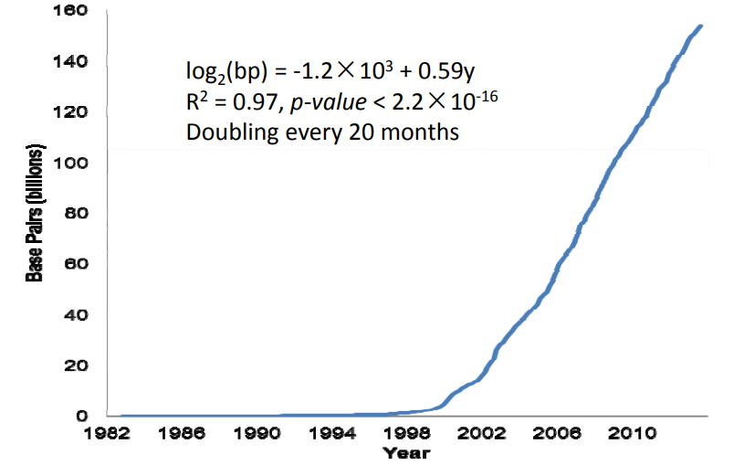
Gene bank growth
Data Source: ftp://ftp.ncbi.nih.gov/genbank/gbrel.txt

Slide 27
What we will study?
Sequencing Technologies
Sequence search/statistics with BLAST (local ungapped sequence alignment)
Global Sequence alignment
Comparative genomic analysis of gene regulation

Slide 28
What we will study?
Modeling & Discovery of Sequence Motifs
Deep learning Models of Genomic and Protein Features
RNA Secondary Structure – Biological Functons & Predicton

Slide 29
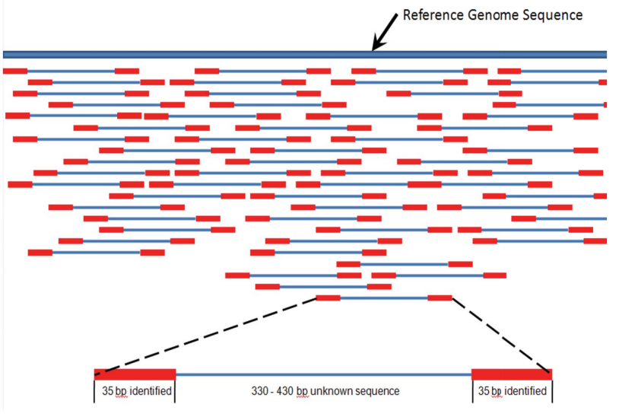
What we will study?
http://en.wikipedia.org/wiki/Genomics
How to index and process millions of DNA sequence reads using the Burrows-Wheeler Transform (BWT) to build genome indexes
Notes:
NGS

Slide 30
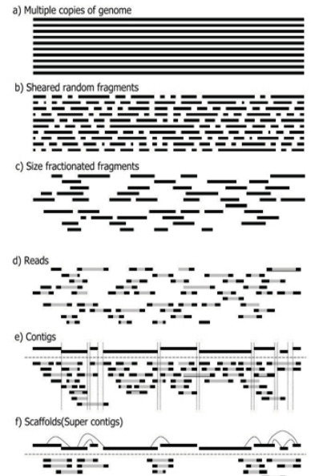
What we will study?
https://www.k.u-tokyo.ac.jp/pros-e/person/shinichi_morishita/shinichi_morishita.htm
How to assemble a reference genome sequence from 10⁸ short sequence reads

Slide 31
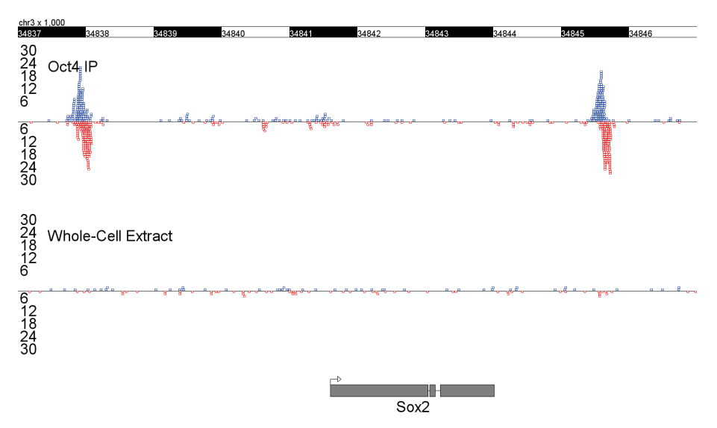
What we will study?
How to discovery where regulatory proteins occupy the genome (ChIP-seq analysis)

Slide 32
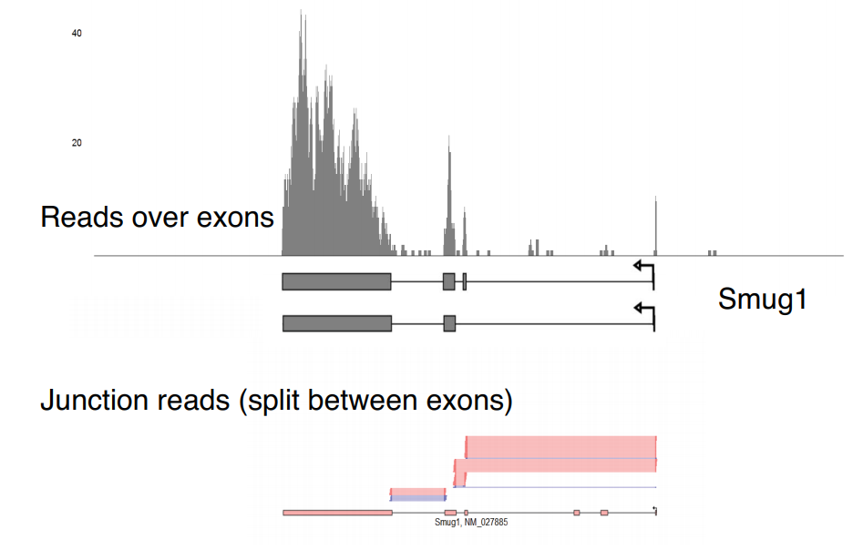
What we will study?
How to measure RNA expression and isoforms using high-throughput DNA sequencing (RNA-seq analysis)

Slide 33
What we will study?
Computational Genetics Module
Understanding genome function in health and disease

Slide 34
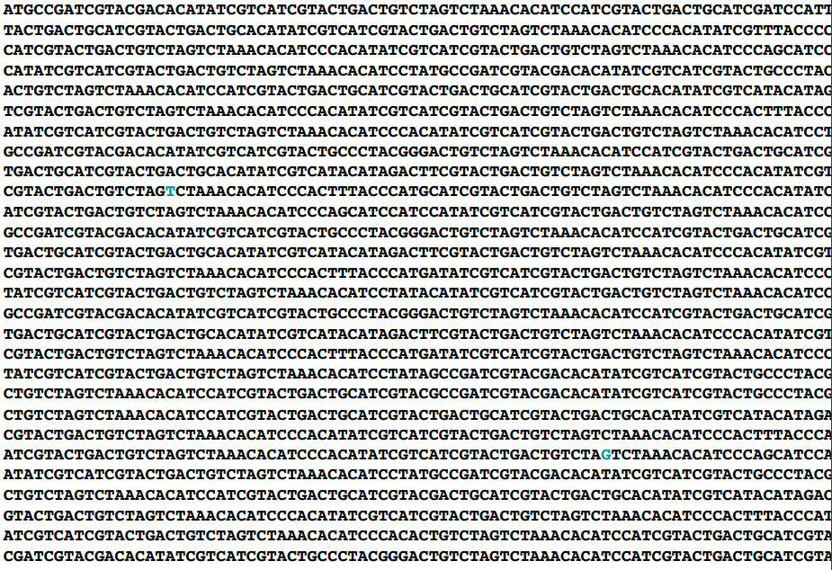
What we will study?

Slide 35
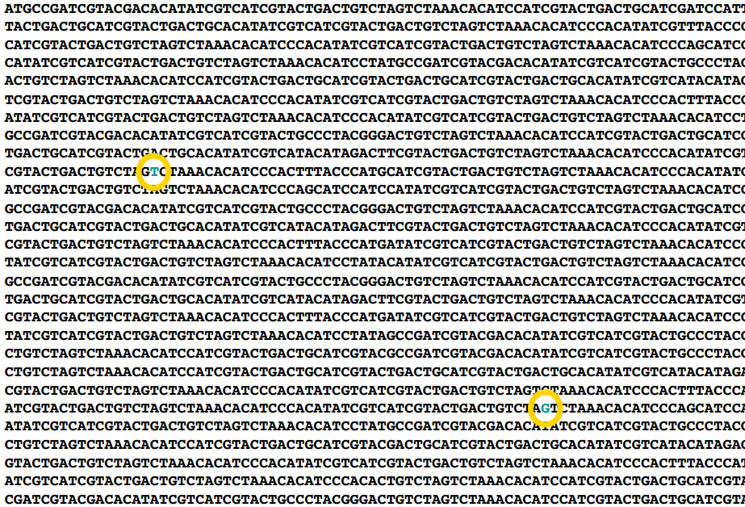
What we will study?

Slide 36
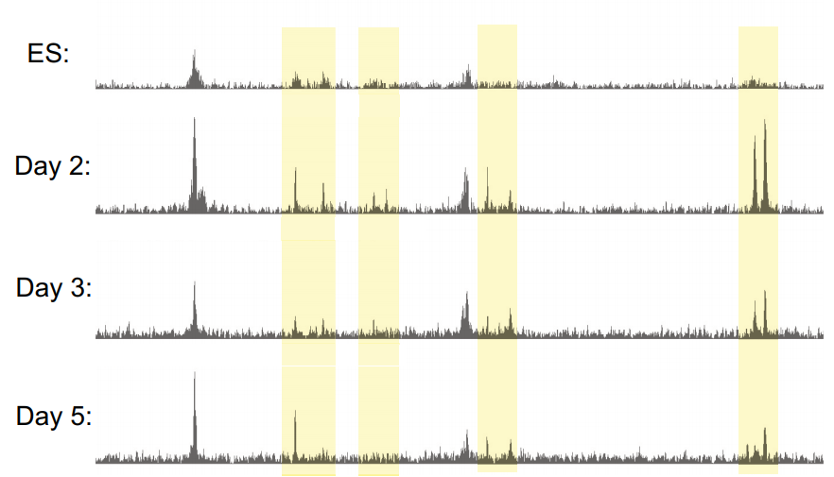
What we will study?
How to use epigenetic and chromatin information to reveal functional genomic elements
Notes:
Yellow shows the regions that are differentially active

Slide 37
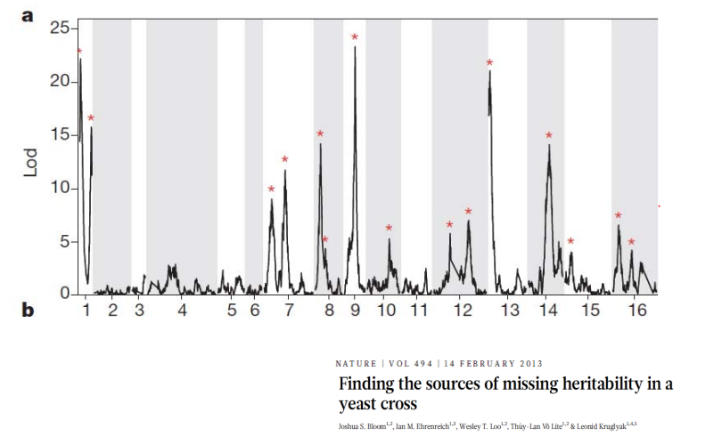
What we will study?
How to discover Quantitative Trait Loci (QTLs) that can predict quantitative traits (such as cellular growth rate)

Slide 38
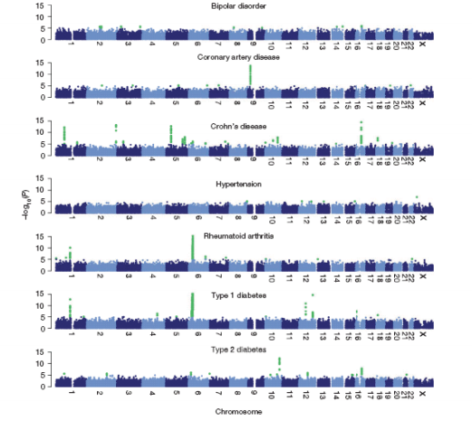
What we will study?
How to perform Genome Wide Association Studies (GWAS) that can discover human variants that predict an increased risk for specific diseases

Slide 39
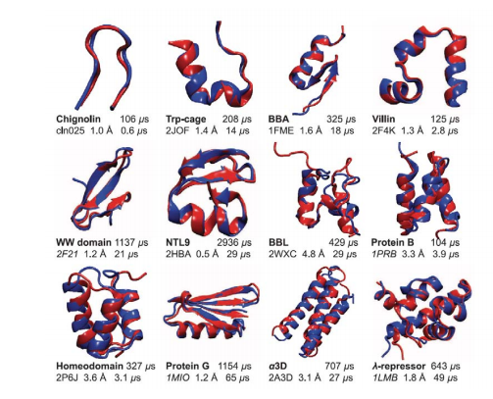
What we will study?
Predicting Protein Structure

Slide 40
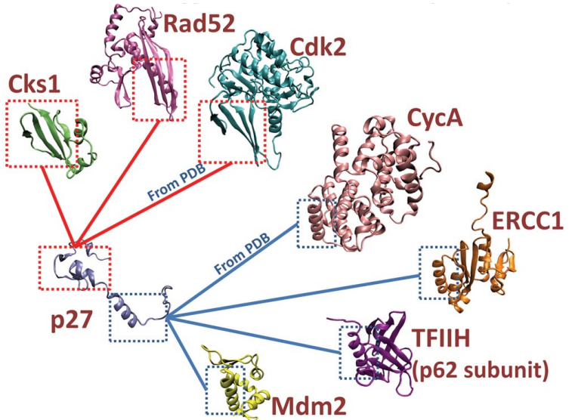
What we will study?
Predicting Interactions

Slide 41
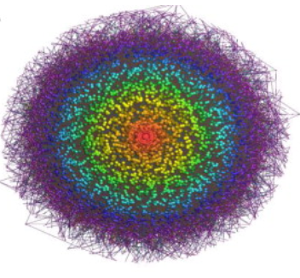
What we will study?
Gene Regulatory Networks
Sumazin, Pavel, Xuerui Yang, et al. "An Extensive MicroRNA-mediated Network of RNA-RNA Interactions Regulates Established Oncogenic Pathways in Glioblastoma." Cell 147, no. 2 (2011): 370-81
Genome-wide inference of sponge modulators identified a miR program-mediated posttranscriptional regulatory (mPR) network including ∼248,000 interactions. Its graphic visualization uses nodes to represent individual RNAs and edges to represent miR program-mediated RNA-RNA interactions.

Slide 42
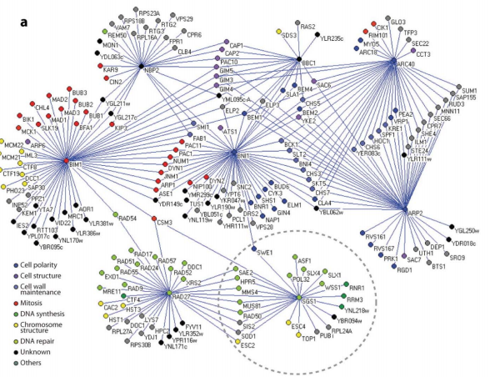
What we will study?
Interaction Networks
Dixon et al. (2009) Annual Review of Genetics Vol. 43: 601-625 (doi:10.1146/annurev.genet.39.073003.114751)

